Slide 1
University of Diyala College of Engineering Dept. of Communications

Slide 2
“ Digital Communications “ By Haidar N. Al-Anbagi Lec (8) Time: (4 hrs) 2017

Slide 3
Delta – Sigma modulation:
As we discussed in the previously, delta modulation process produces the approximation form of the derivative of the signal. That is considered a drawback of delta modulation because of the accumulated error caused by the transmission disturbances such as noise. The best procedure to overcome this problem is to integrate the message signal prior to delta modulation. Integrating the message signal before DM process has come up with the following advantages:
1. The low frequency content of the input signal is pre-emphasized.
2. The correlation between adjacent samples is increased even more and that reduces the quantizer error.
3. The simplicity of the receiver design.
Figure (1) shows two versions of D- Sigma modulation transmitter and receiver.
.

Slide 4
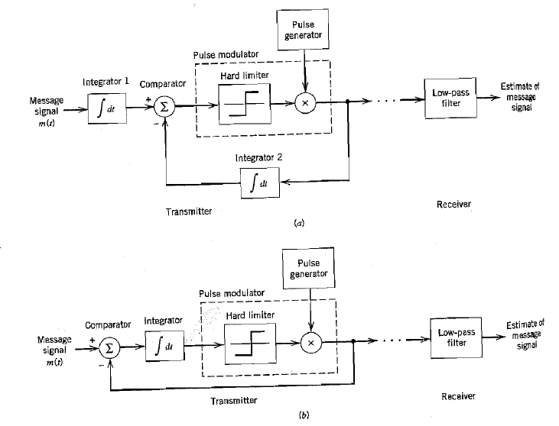
Figure (1). Two versions of D- Sigma modulation system

Slide 5
Looking at figure (1), the receiver simply consists of a low pass filter. Also, figure (1b) shows that the two integrators can be combined into one to improve the simplicity of the implementation. The second version is called smoothed version of 1-bit pulse code modulation. The term “smoothed” is used to refer to the fact that the comparator output is integrated prior to the quantization process. The quantization in this version is 1- bit quantization which means only two levels are used to represent data. In DM, the oversampling is used to simplify both the transmitter and the receiver; however, the price for this will be the expansion in the bandwidth. Depending on what application the modulation is needed for, the complexity and the transmission BW are prioritized.

Slide 6
Adaptive delta modulation (ADM):
Before we discuss ADM, we should discuss the disadvantage of the DM that ADM has dealt with. DM suffers serious disadvantage which is the threshold and the overload effects. These problems can be seen obviously in figure (2). The variations in m(t) smaller than the step value (threshold of coding) are lost in DM. In addition, when m(t) changes too fast, DM cannot follow up quickly and that is called overloading, or so called as slop overload. The problem of overloading adds up noise to DM signal and that noise is called slope overload noise and it is considered the most important limiting factor of the DM system. The slope overload noise can be reduced by increasing the step size, however, it increases granular noise as a result. There is an optimum value of the step size which gives the minimum noise and this optimum value depends on $f_{s}$ and the nature of the signal.

Slide 7
Limitation of PCM:
Figure (2) Threshold and overload effects in DM

Slide 8
DM causes no slope overload if the following condition is satisfied:
$\left|m(t)\right|$ < σ $f_{s}$ (1)
Where, σ = step size.
$f_{s}$= sampling frequency.
Example: m(t) = A cos (wt) , then the condition becomes
${\left|m(t)\right|}_{max}$ = WA < $f_{s}$σ then,
$A_{max}$ = σ $f_{s}$ / w .

Slide 9
Therefore, the higher the frequencies, the overload occurs for small values of A (amplitudes). For voice signals whose frequency components up to 4 KHz, $A_{max}$ can be calculated by using $W_{r}$= 2*π*800 in the equation of $A_{max}$ , then
$[{A_{max}]}_{voice}$= σ $f_{s}$ / $w_{r}$ (2)
Where $w_{r}$ = the reference frequency.
Fortunately, the voice spectrum (as well as the television signal) decays with frequency and closely follows the overload characteristics and that is why DM is a good choice for voice and television signals.
Figure 8 Shows non uniform quantization

Slide 10
ADM
As we mentioned, DM suffers from a problem which is the “Dynamic range of amplitudes is too small because of the threshold and overlap effects.” To handle this problem, an adaptation must be involved in the step size to eliminate the effects of the threshold and overload. In adaptive delta modulation (ADM), the adaptation of the step size σ should be according to the input signal derivative.
Looking at figure (3), when:
1. The signal m(t) falls rapidly, the DM cannot keep up too fast and that is called overload problem, therefore, ADM has come up with the solution by making the step size bigger during this period. Doing so, ADM can avoid the overload problem.
2. The signal m(t) slope is too small, ADM reduces the step size σ to reduce the threshold and the granular noise as a result.

Slide 11
Figure (3) DM problems

